Slide 1
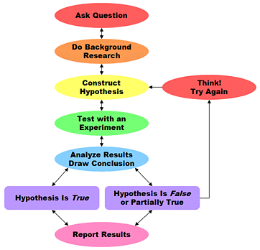
Bell ringer #5: 11/5/19
1. What was the major difference between the Geocentric Theory and the Heliocentric Theory?
2. Why did the Heliocentric Theory upset religious leaders during the Scientific Revolution?
The Sun King, Louis XIV, felt he was the center of the universe.
The Catholic Church was jealous they did not realize this observation.
It challenged long-held religious teachings and beliefs.
3. Based on the diagram, what was one way Copernicus, Galileo, and others influenced how scientists work today?
Scientists now publish a conclusion based on collected data & experiments.
Scientists were no longer as useful with the scientific method.
Scientists never even really used the scientific method after the Enlightenment.

Slide 2
Enlightenment
Unit 5

Slide 3
What was the enlightenment?
The Scientific Revolution Sparks the Enlightenment
Transformed the way people looked at the world
Scientific success convinced educated Europeans of the power of human reason
Natural Law-– rules discoverable by reason
Enlightenment
European intellectual movement of the late 17th and 18th centuries emphasizing reason and individualism rather than tradition.

Slide 4
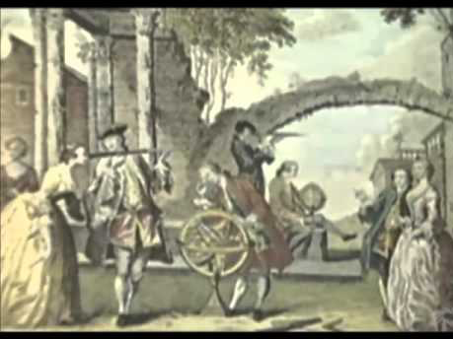

Slide 5
Central Ideas of the enlightenment
The methods of natural science should be used to understand all aspects of life– through the use of reason.
Discover the natural laws of human society as well as the natural world ( a “social science”)
The idea of progress– confidence in human power (human reason to improve society)
Rejection of superstition and tradition
Tolerance and equality

Slide 6
Enlightenment thinkers
Nothing is beyond the reach of the human mind. Through the use of reason, people and governments can solve every social, political, and economic problem.
Locke- natural rights-– life, liberty, property
Hobbes- humans are naturally selfish and must be governed
Montesquieu- separation of powers
Rousseau- direct democracy
Voltaire- freedom of speech
Smith- laissez-faire capitalism
Wollstonecraft- Women’s equality

Slide 7
Enlightenment ideas spread
New Ideas Challenge Society
More and more people saw that reform was necessary to achieve a just society
War of Censorship (restricting access to ideas and information)
Arts and Literature Reflect New Ideas
Baroque Period- grand style, movement, huge, colorful, full of excitement, glorified events and battles
Rococo Style- lights, elegant, charming; encouraged imagination

Slide 8
Enlightenment ideas spread
Enlightened Despots Reflect New Ideas
Enlightened Despotism- absolute rulers who used their power to bring about political and social change
Became a trend among the wealthy
Lives of the Majority Change Slowly
Most Europeans were untouched by these ideas at first
Slowly, these ideas spread and would eventually transform peasant life in Europe
Significance:
Ideas provided the basis of American Constitution (shaped U.S. government)
***Eventually, the Enlightenment provided the philosophical basis of the American Revolution

