Slide 1
Homework
Read the Following Power Point and take notes for the Executive branch. If there is content you do not understand, feel free to research it further. This should be done before class Monday 2/25/19.

Slide 2
Executive Branch: THE PRESIDENT
EQ: What are the qualifications for president? How is the president elected?

Slide 3
https://youtu.be/PS6BLJuHvY8

Slide 4
THE PRESIDENT
The President is the head of the Executive branch.
The constitution lists only three rules about who can be president(Article II)
35 years old
Native-born US citizen
US resident for previous 14 years

Slide 5
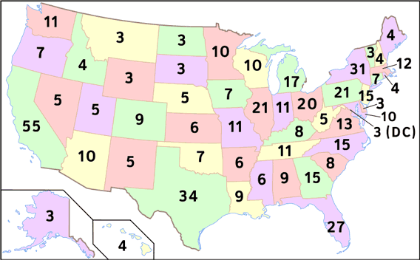
PRESIDENTIAL ELECTIONS
The constitution sets up an indirect system for electing the president.
When voting for a candidate, you are actually voting for a group of electors pledged to that candidate. (Electorate)
Presidents are officially elected by the Electoral College. Each state has a group of people who vote for whichever candidate wins the popular vote in the state.
There are 538 total electors; a candidate needs 270 to win.
#determined by House members and Senate members

Slide 6
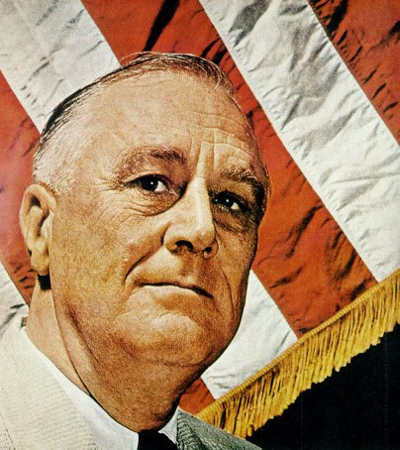
TERMS IN OFFICE
Presidents serve 4 year terms (2 terms max)
They can only serve two terms based on the 22nd amendment
FDR was the only president to serve more than two terms

Slide 7
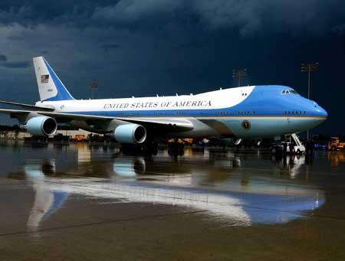
BENEFITS OF BEING PRESIDENT
$400,000 annual salary (205,700 after they leave office)
The President also receives a $50,000 non-taxable expense account.
Free housing at the White House and Camp David (Maryland)
Free food and domestic staff
Free travel on Air Force One.

Slide 8
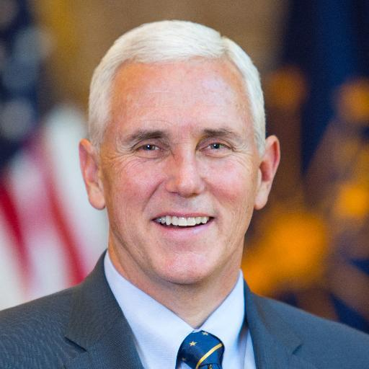
THE VICE PRESIDENT
Same requirements as the President.
Official leader of the Senate but only votes to break a tie.
Takes over if president is found unable to carry out his duties.

Slide 9
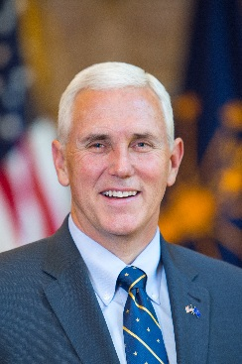
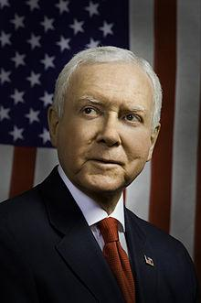
PRESIDENTIAL SUCCESSION
1841: Harrison dies leaving no steps for who should take over presidency.
Tyler declares himself president
1947: Congress passes presidential succession act.
25th Amendment: Explains presidential succession as follows:
If President dies or resigns, the VP takes over.
After the VP is: Speaker of the House→ President Pro Tempore→ Secretaries of Executive Agencies in the order they were created
Pence Pelosi Grassley

