Slide 1
Bell Ringer #6 2/26/19
What is the major way in which the Executive Branch can check the Legislative Branch?
Which situation best illustrates the President’s role as Head of State?
Signing a bill into law
Awarding a medal of honor to a soldier
Sending troops into battle
Which presidential role would come into play if the president were to meet and make a treaty with the leader of Russia?

Slide 2
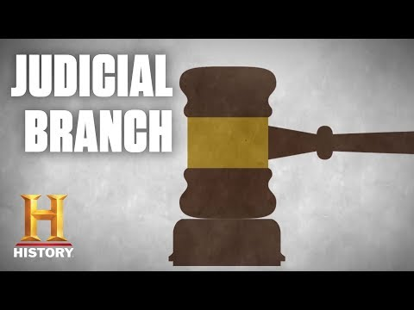
https://youtu.be/9giPmCWnepU

Slide 3
The Federal Court System
EQ: HOW IS THE FEDERAL COURT SYSTEM ORGANIZED? WHAT TYPES OF CASES ARE HEARD IN FEDERAL COURT?

Slide 4
FEDERAL COURT ORGANIZATION
SUPREME
Original/Appellate/Exclusive
APPEALS
Appellate Jurisdiction
DISTRICT
Original Jurisdiction

Slide 5
District Court
Each state has its own district court system.
Both civil and criminal cases are heard.
District Courts
How many: 94
Judges per courtroom: 1
Jurisdiction: each state has at least one district, some more than one
What kinds of cases: original jurisdiction on criminal cases

Slide 6
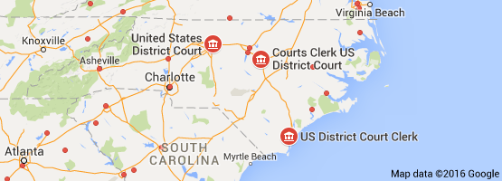
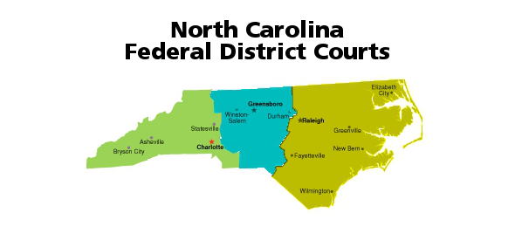

Slide 7
Appeals Court
Decides appeals cases from district courts.
appellate jurisdiction: authority to hear a case appealed from lower court
Court of Appeals
How many: 12
Judges per courtroom: 3
Jurisdiction: multiple states
What kinds of cases: cases already heard in district court

Slide 8
Circuits:
Someone who loses in the District Court has a legal right to appeal to the United States Circuit Court of Appeals.
Appeal- legal proceeding by which a case is brought before a higher court for review of the decision of a lower court.
The Court of Appeals is divided into regions--“circuits.”
11 circuits in the United States that have number names. Washington, D.C. is just known as the “D.C. Circuit”.
Each Circuit Court contains a number of district courts.

Slide 9
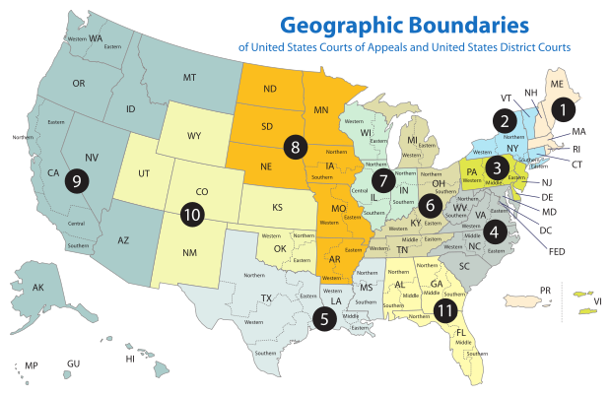

Slide 10
Court of Appeals Decisions
Do not hold trials
Instead, decide an appeal in 1 of 3 ways:
Upholding the original decision
Reversing that decision
Remanding the case: sending case back to lower court to be tried again.
Panel of 3 Judges

Slide 11
The Supreme Court
Highest judicial body in the US
Leads the federal Judiciary
Supreme Court
How many: 1 court, 9 justices
Judges per courtroom: 9
Jurisdiction: entire US (Executive)
What kinds of cases: appeals from lower courts and diplomats from other countries. Cases involving constitution, acts of Congress, Treaties

Slide 12
Jurisdiction
Article three of the constitution gives federal courts jurisdiction or authority to hear and decided cases, however only certain cases get judged by the Federal Court.

Slide 13
Cases Heard by Federal Courts
The Constitution | If a constitutional law has been violated Ex. Brown v Board
Federal laws | Try people accused of Federal crimes such as kidnapping, tax evasion, and counterfeiting.
Disputes Between States | Disagreement between two or more states Ex. CO and CA disagreeing over use of the CO river
Citizens from Different States | Individuals from separate states have a disagreement Ex. Business agreements, Custody

Slide 14
Cases Continued
The Federal Government | Actions made by Federal Agencies Ex. Nixon ordering the CIA to block the FBI investigation of Watergate.
Foreign Governments and Treaties | Any foreign government versus America is tried in federal court Ex. Native American Treaties broken
Admiralty and maritime laws | Outside territorial waters Ex. Personal injury aboard a cruise ship.
US Diplomats | Breaking American laws in another country.

Slide 15
Other Key Terms
Opinion- offers a detailed explanation of legal thinking behind a court’s decision.
Precedent- legal standard set that give guidance o other judges offering a model upon which to base their own decisions on similar cases.
Common law- a legal system of law based on precedents and customs.
Majority opinion– statement that presents the views of the majority of supreme court justices on a case.
Dissenting opinion- official statement issued by supreme court justices who oppose the majority decision.

Slide 16
Korematsu v. US
https://www.youtube.com/watch?v=F_fC3kSuxVI

