Slide 1
Victory in Europe and the Pacific

Slide 2
What Wartime conferences took place between the “Big Three”?
FDR, Churchill, and Stalin
Met to coordinate military strategies and future peace plans
Casablanca (Jan. 1943) → FDR and Churchill agreed to invade Sicily then mainland Italy
Teheran (Nov. 1943)
The Big Three met for the first time in Teheran

Slide 3
Agreed that the U.S. and Britain would open up the western front by invading France in Spring of 1944
Agreed that the USSR would invade Germany and eventually join the war against Japan
Yalta Conference (Feb. 1945)
The Big Three met up to make plans for the world after the war
Germany would be divided into occupation zones
Free elections for the “liberated” countries of Eastern Europe (under control of Soviet Army)
Soviets would enter the war against Japan (Entered August 8, 1945…Japan surrendered August 10, 1945)

Slide 4
A new world peace organization would be formed at a post war conference in San Francisco
Potsdam Conference (July 17-August 2, 1945)
Only Stalin remained of the Big Three
Truman replaced FDR, Clement Attlee replaced Churchill
Agreed to issue a warning to Japan to surrender unconditionally
Agreed to hold war-crime trials of Nazi leaders → Nuremburg Trials (Nov. 1945-Oct.1946)
Individuals must be held accountable for their crimes against humanity

Slide 5
How did the War in Europe End?
D-Day invasion
June 6, 1944 → the Allied invasion of German occupied France and opening of the western front
Codenamed Operation Overlord
Planned and executed by Supreme Allied Commander of European Forces → Dwight D. Eisenhower
Allied troops (U.S., British, and Canadian) crossed English Channel and landed on the Normandy coast of France

Slide 6
Allies reached Paris by August 25, 1944
By September 1944, Allied troops crossed the German border
The Battle of the Bulge (Dec. 1944)
German counterattack in Belgium
Temporarily set back Allied forces
By April 1945, U.S. forces approached Berlin from the west and the Soviets approached from the east
last major German offensive campaign (Ardennes Offensive) on the Western Front during World War II
Unsuccessful for Germany
Seeing that Berlin would fall to the Allies, Hitler committed suicide April 30, 1945
V-E Day: Nazi Germany surrendered on May 4, 1945– end of WWII for European Theatre

Slide 7
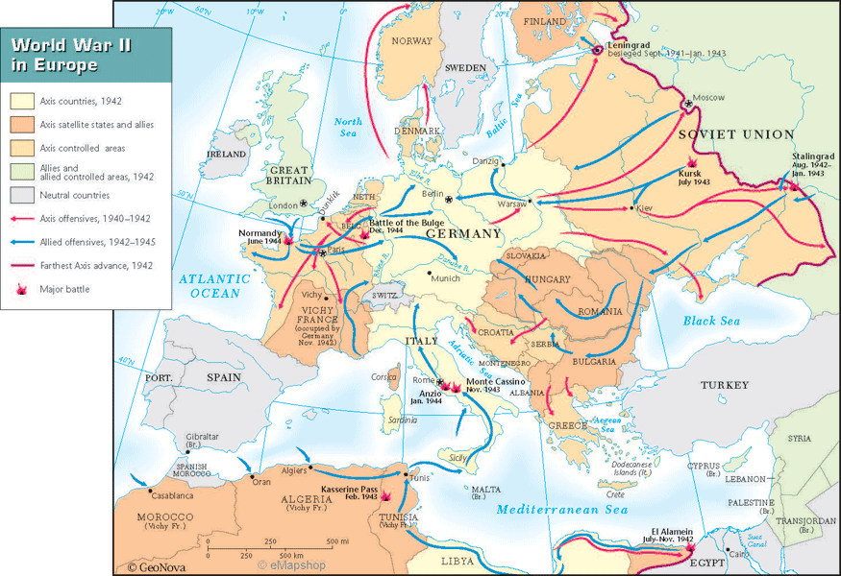
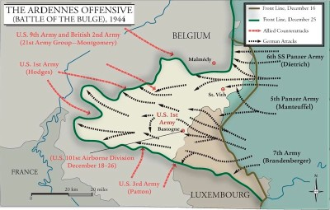
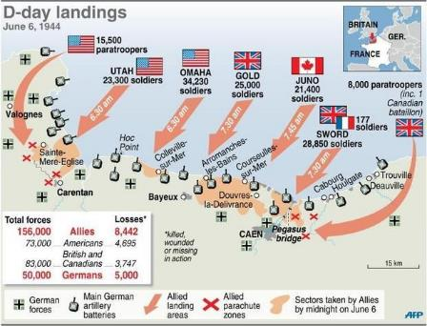

Slide 8
How Did the War in the Pacific End?
The war in the Pacific was headed by General Douglas MacArthur, Supreme Allied Commander in the Pacific
The U.S. began the process of getting within Japan’s home islands by seizing strategic islands in the Pacific
Island-hopping → U.S. strategy of bypassing strongly held Japanese islands, isolating them with air and naval power, and then move on rapidly towards Japan
Began in 1942

Slide 9
The Battle of Leyte Gulf (Oct. 1944)
Largest naval battle in history
U.S. virtually destroyed the Japanese navy
Japanese used Kamikaze pilots to attack U.S. ships
The Battle for Okinawa (April-June 1945)
50,000 American soldiers killed
100,000 Japanese soldiers killed
The capture of Okinawa gave the U.S. control of an island close enough to invade Japan
After Okinawa, the U.S. began preparing a large invasion force to attack Japan

Slide 10
Extremely high casualties were projected for both sides
The Manhattan Project
Began in 1942, headed by physicist J. Robert Oppenheimer
Project to develop the atomic bomb
Tested July 16, 1945 in New Mexico
Harry Truman warned Japan to surrender or face “utter destruction” in Potsdam Declaration
When Japan refused, the U.S. dropped two atomic bombs

Slide 11
August 6, 1945 the Enola Gay dropped the bomb on Hiroshima
Flattened 42 square miles
Killed at least 80,000 people instantly
When the Japanese still did not surrender, another bomb was dropped on Nagasaki on August 9, 1945
Over 250,000 people died from both bombs
Japanese surrender
August 10, 1945 Emperor Hirohito announced surrender
Sept. 2, 1945 Japan formally surrendered aboard the battleship Missouri--VJ-Day

Slide 12
