Slide 1
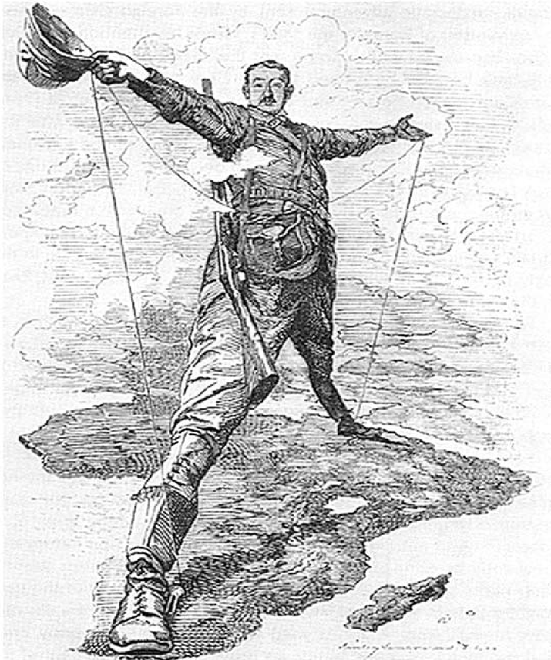
Bell Ringer #3: 12/3/19
Use the following image to answer questions 1-2.
1. On what is Cecil Rhodes standing?
a. England c. Asia
b. Africa d. North America
2. Based on this cartoon, what can you infer about Cecil Rhodes’s attitude towards Africa?
a. He views Africa as a beautiful and diverse continent
b. He views Africa as a strong continent in need of independence from Europe
c. He views Africa as inferior and therefore ripe for European control
3. Define the term Imperialism in your own words (Hint: we talked about this in class yesterday)

