Slide 1
WWI Christmas truce
https://www.youtube.com/watch?v=6KHoVBK2EVE
The Christmas truce was a series of widespread but unofficial ceasefires along the Western Front of World War I around Christmas 1914. The Christmas truce occurred during the relatively early period of the war

Slide 2
Wilson, War & Peace

Slide 4
How Was the U.S. Armed forces used in WWI?
The American Expeditionary Force (AEF)
General John Pershing
Came in small numbers in 1917 before large number of troops were deployed in 1918
Initially used to plug in holes or weak spots in British and French lines
By summer of 1918, the AEF assumed independent responsibility for a segment of the western front

Slide 5
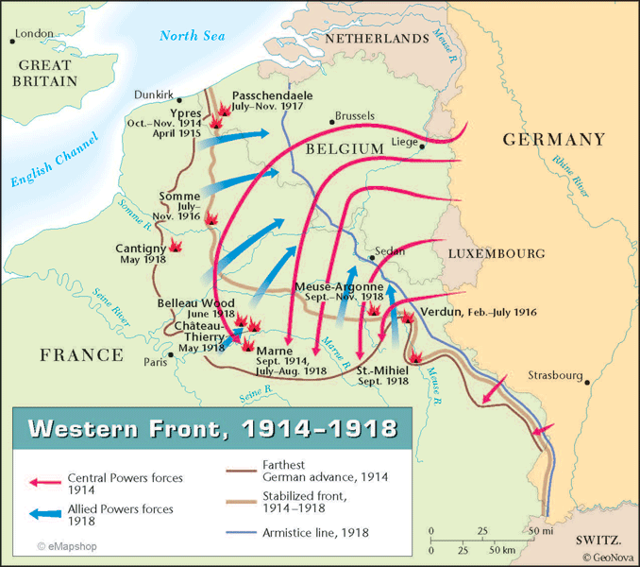
Armistice (truce)- end of War!
On November 11, 1918 the Germans signed an armistice
The 11th hour, of the 11th day, of the 11th month
Germans agreed to surrender their weapons, give up much of their navy, and evacuate occupied territory
https://www.youtube.com/watch?v=U10ON2aau3g

Slide 6
What was Wilson’s plan for peace?
Wilson promoted that the war was about peace and freedom after being called out by Lenin that the war was an imperialistic land grab
The Fourteen Points: Wilson’s peace plan and post war plan for the world → “peace without victory”
Freedom of the seas
An end to secret treaties and alliances
Arms reduction
Free trade
Self-determination for colonies of the Central powers
The League of Nations

Slide 7
The Treaty of Versailles
Peace Conference (Jan. 1919) at Palace of Versailles
Representative from all participating Allied nations
Wilson became the first US President to travel abroad for diplomatic conference
Republicans criticized Wilson for lack of Republicans at conference
The Big Four: leaders of the four major powers at the Peace Conference
David Lloyd George: Great Britain
Georges Clemenceau: France
Vittorio Orlando: Italy
Woodrow Wilson: U.S.

Slide 8
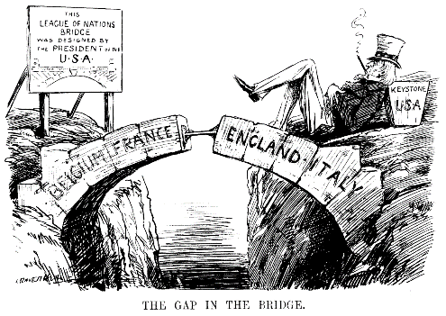
Conflict between Wilson and the Big Four
European leaders of Big Four pushed for treaty that punished Germany and compensated the Allies for their loses
Wilson wanted to implement his “peace without victory” with his Fourteen Points
Wilson agreed to compromise on most of his Fourteen Points in exchange for acceptance of the League of Nations

Slide 9
What were the terms of the Treaty of Versailles
Germany was disarmed and stripped of its colonies
Germany was forced to admit guilt for the war and accept French occupation of the Rhineland for 15 years
Germany was forced to pay reparations to Britain and France
Estonia, Latvia, Lithuania, Finland, Poland, Czechoslovakia, and Yugoslavia were established as independent nations
Signers of the treaty would join League of Nations → international peacekeeping organization

Slide 10
How did Wilson struggle to ratify the treaty of Versailles?
The treaty needed a 2/3 majority vote in the US Senate to be ratified
The Republicans controlled the Senate and objected to the U.S. joining the League of Nations
Anti-ratification group headed by Henry Cabot Lodge
The old Washington-avoid-foreign-alliances thing
The league might lead to violations of the Monroe Doctrine

Slide 11
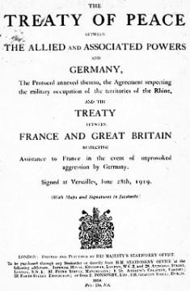
The Senate voted twice on the Treaty of Versailles, rejecting it both times
The U.S. eventually signed a separate treaty with Germany
The U.S. never signed the Treaty of Versailles
The U.S. never joined the League of Nations → not very effective

Slide 12
warren G. Harding
Warren Gamaliel Harding was the 29th president of the United States
Succeeded Woodrow Wilson
Motto “Return to Normalcy”

Slide 13
Match the people:
Bick Stick Diplomacy & Panama Canal
Monarch of Hawaii
U.S. Naval Captain who supported imperialism for Naval gain
Roosevelt’s Corollary
Yellow Journalists
Led Filipino insurrection against U.S. forces in the Philippines
Petitions Congress to go declare war on Germany
Leader of Food Administration
Created the Fourteen Points
Called for a “return to normalcy” during his presidential campaign
Pulitzer & Hearst
Theodore Roosevelt
Herbert Hoover
Emilio Aguinaldo
Alfred Mahan
Woodrow Wilson
Warren G. Harding
Lili Uokalani

Slide 14
Answer key
Bick Stick Diplomacy & Panama Canal B
Monarch of Hawaii H
U.S. Naval Captain who supported imperialism for Naval gain E
Roosevelt’s Corollary B
Yellow Journalists A
Led Filipino insurrection against U.S. forces in the Philippines D
Petitions Congress to go declare war on Germany F
Leader of Food Administration C
Created the Fourteen Points F
Called for a “return to normalcy” during his presidential campaign G
Pulitzer & Hearst
Theodore Roosevelt
Herbert Hoover
Emilio Aguinaldo
Alfred Mahan
Woodrow Wilson
Warren G. Harding
Lili Uokalani

Slide 15
Review: Family Feud

